Slide 1




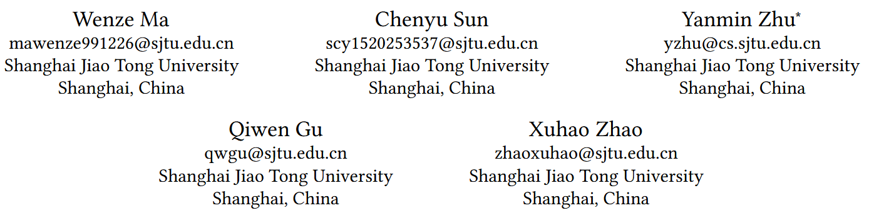





ATAI
Advanced Technique of Artificial Intelligence
ATAI
ChongqingUniversity _{AdvancedTechniqueof}
of Technology Artificial Intelligence
Chongqing University of Technology
Chongqing University ^{ATAI}
_{of Technology} Advanced Techniqueof
Artificial Intelligence
Chongqing University of Technology
Chongqing University of Technology
Information-Guided Selective Modality-Interest Alignment for
Multimodal Recommendation
code: https://github.com/Wenze1/AMUR
—— CIKM ’26
Reported by Junsi Chen
1

Slide 2
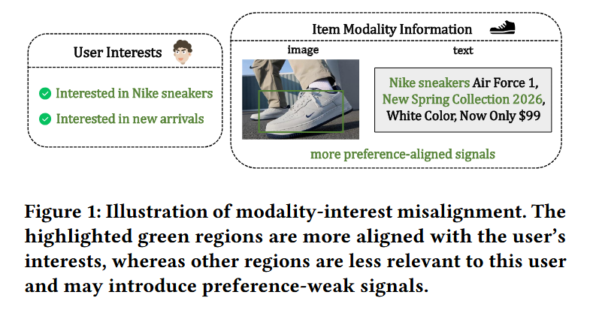
ATAI
AdvancedTechniqueof
Artificial Intelligence
ATAI
ChongqingUniversity _{AdvancedTechniqueof}
of Technology Artificial Intelligence
ChongqingUniversity of Technology
Motivation
(1) Directly incorporating all modality information does not necessarily lead to better user preference modeling. In real-world recommendation scenarios, users often make decisions based on only part of the modality content.
(2) Different modalities naturally contain both shared semantics and modality-specific complementary details. Directly aligning the full modality representations may over-suppress such modality-specific information, which can also be useful for recommendation.

Slide 3

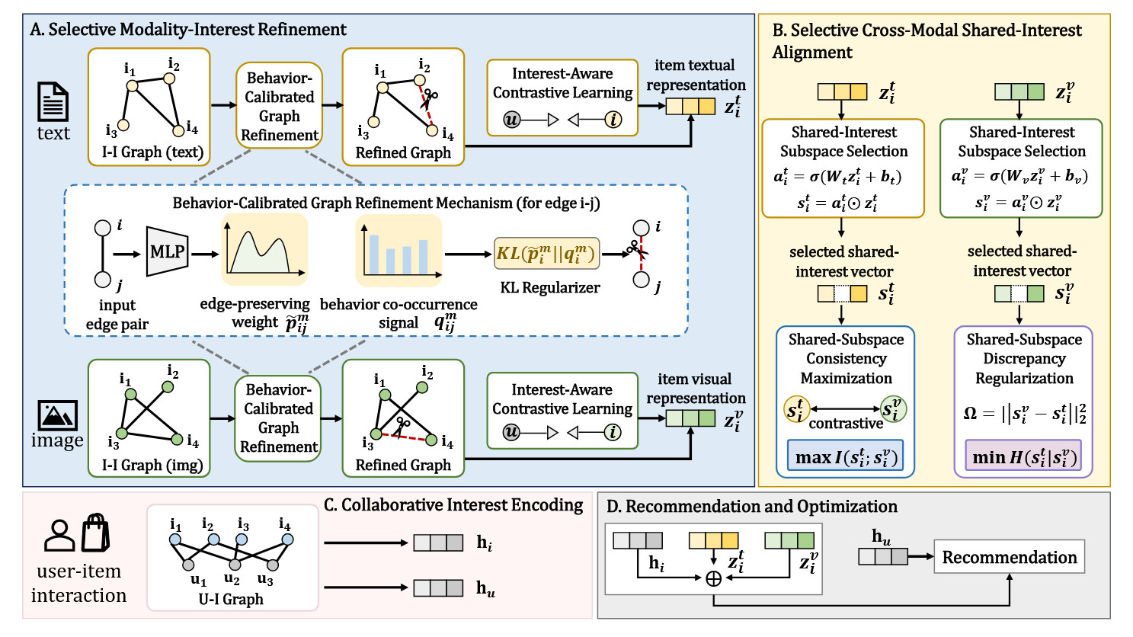
ChongqingUniversity of Technology
ATAI
AdvancedTechniqueof
Artificial Intelligence
ATAI
ChongqingUniversity _{AdvancedTechniqueof}
of Technology Artificial Intelligence
Overview

Slide 4
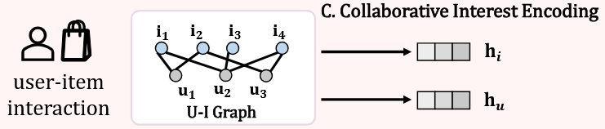


ChongqingUniversity of Technology
ATAI
AdvancedTechniqueof
Artificial Intelligence
ATAI
ChongqingUniversity _{AdvancedTechniqueof}
of Technology Artificial Intelligence
Method

Slide 5

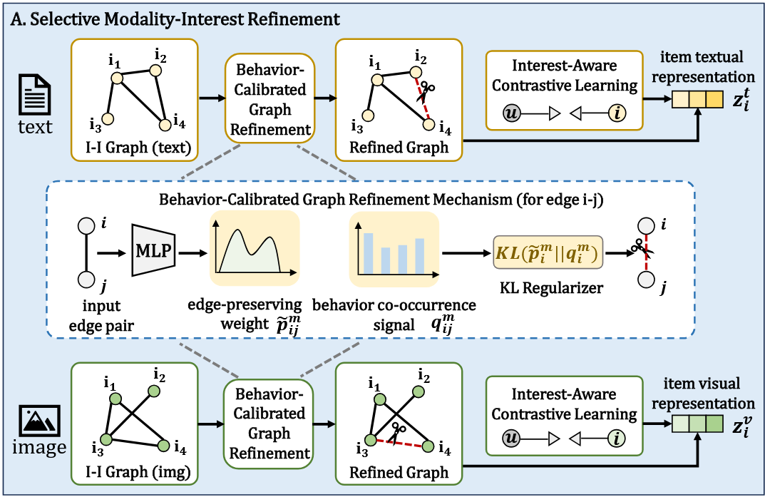








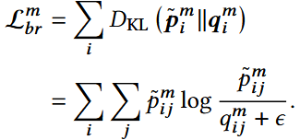

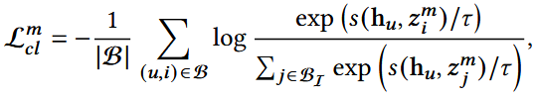


ChongqingUniversity of Technology
ATAI
AdvancedTechniqueof
Artificial Intelligence
ATAI
ChongqingUniversity _{AdvancedTechniqueof}
of Technology Artificial Intelligence
Method
(9)
(10)
(11)
(12)
(13)
(15)
(14)
(16)
(17)
(18)

Slide 6
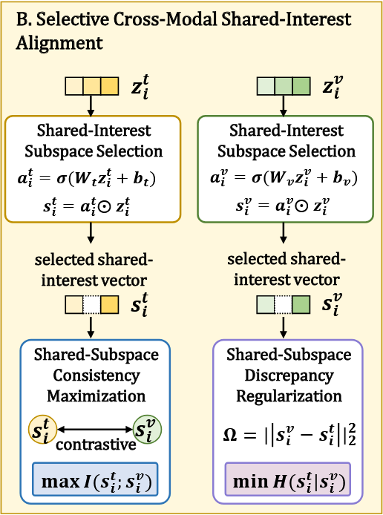

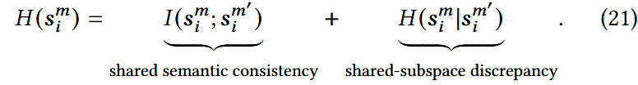
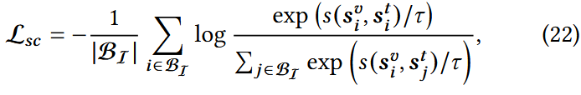


ChongqingUniversity of Technology
ATAI
AdvancedTechniqueof
Artificial Intelligence
ATAI
ChongqingUniversity _{AdvancedTechniqueof}
of Technology Artificial Intelligence
Method

Slide 7
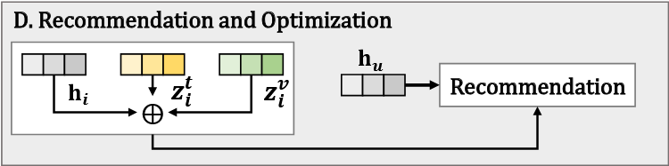


ChongqingUniversity of Technology
ATAI
AdvancedTechniqueof
Artificial Intelligence
ATAI
ChongqingUniversity _{AdvancedTechniqueof}
of Technology Artificial Intelligence
Method

Slide 8

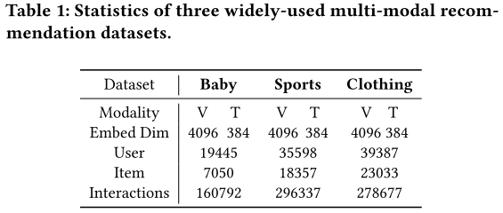
ATAI
Advanced Technique of Artificial Intelligence
ATAI
ChongqingUniversity _{AdvancedTechniqueof}
of Technology Artificial Intelligence
Chongqing University of
Technology
Chongqing University ^{ATAI}
_{of Technology} Advanced Techniqueof
Artificial Intelligence
Chongqing University of Technology
Chongqing University of Technology

Slide 9
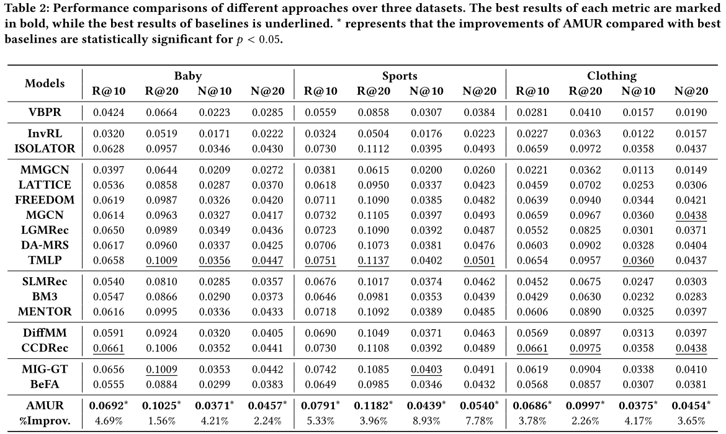
ATAI
Advanced Technique of Artificial Intelligence
ATAI
ChongqingUniversity _{AdvancedTechniqueof}
of Technology Artificial Intelligence
Chongqing University of
Technology
Chongqing University ^{ATAI}
_{of Technology} Advanced Techniqueof
Artificial Intelligence
Chongqing University of Technology
Chongqing University of Technology

Slide 10
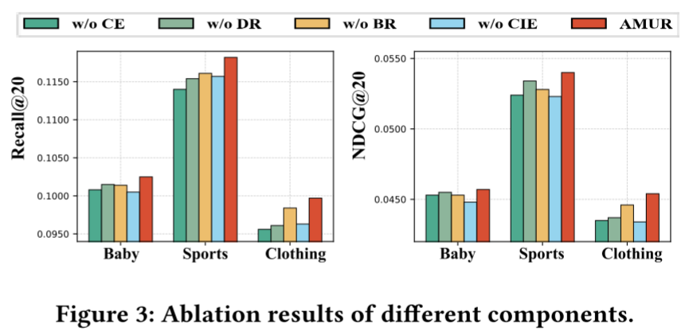
ATAI
Advanced Technique of Artificial Intelligence
ATAI
ChongqingUniversity _{AdvancedTechniqueof}
of Technology Artificial Intelligence
Chongqing University of
Technology
Chongqing University ^{ATAI}
_{of Technology} Advanced Techniqueof
Artificial Intelligence
Chongqing University of Technology
Chongqing University of Technology

Slide 11
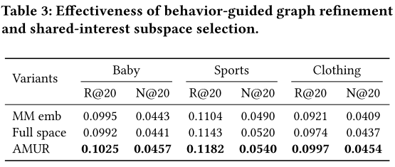
ATAI
Advanced Technique of Artificial Intelligence
ATAI
ChongqingUniversity _{AdvancedTechniqueof}
of Technology Artificial Intelligence
Chongqing University of
Technology
Chongqing University ^{ATAI}
_{of Technology} Advanced Techniqueof
Artificial Intelligence
Chongqing University of Technology
Chongqing University of Technology

Slide 12
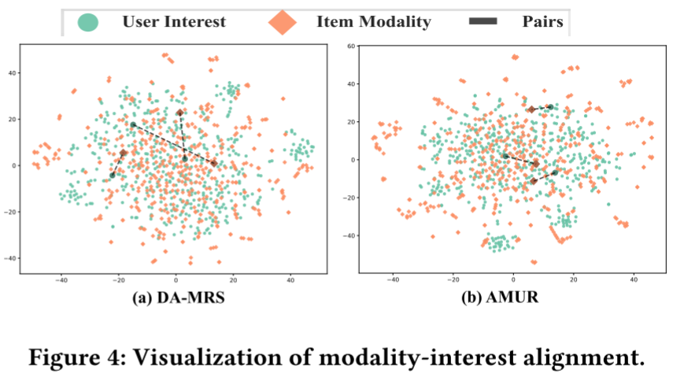
ATAI
Advanced Technique of Artificial Intelligence
ATAI
ChongqingUniversity _{AdvancedTechniqueof}
of Technology Artificial Intelligence
Chongqing University of
Technology
Chongqing University ^{ATAI}
_{of Technology} Advanced Techniqueof
Artificial Intelligence
Chongqing University of Technology
Chongqing University of Technology

Slide 13
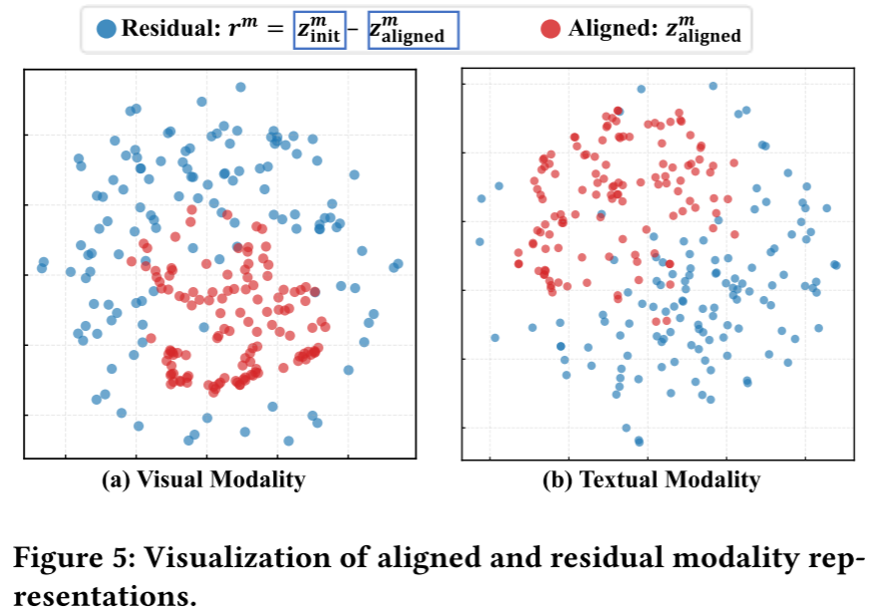
ATAI
Advanced Technique of Artificial Intelligence
ATAI
ChongqingUniversity _{AdvancedTechniqueof}
of Technology Artificial Intelligence
Chongqing University of
Technology
Chongqing University ^{ATAI}
_{of Technology} Advanced Techniqueof
Artificial Intelligence
Chongqing University of Technology
Chongqing University of Technology

Slide 14
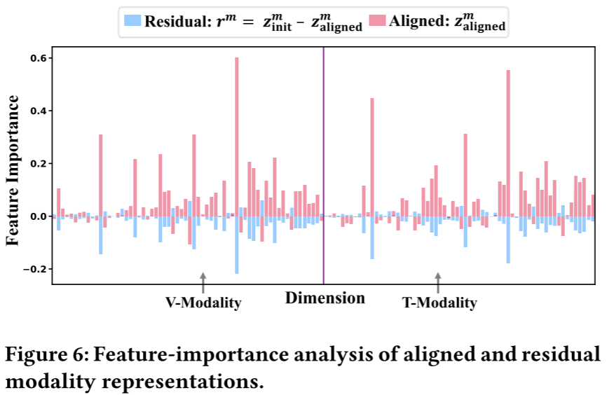
ATAI
Advanced Technique of Artificial Intelligence
ATAI
ChongqingUniversity _{AdvancedTechniqueof}
of Technology Artificial Intelligence
Chongqing University of
Technology
Chongqing University ^{ATAI}
_{of Technology} Advanced Techniqueof
Artificial Intelligence
Chongqing University of Technology
Chongqing University of Technology

Slide 15
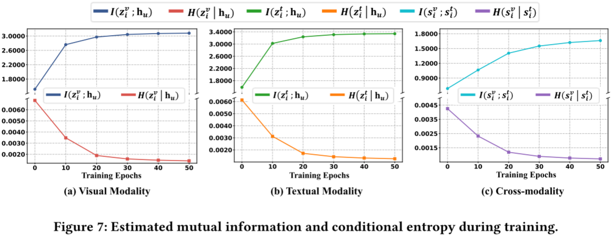
ATAI
Advanced Technique of Artificial Intelligence
ATAI
ChongqingUniversity _{AdvancedTechniqueof}
of Technology Artificial Intelligence
Chongqing University of
Technology
Chongqing University ^{ATAI}
_{of Technology} Advanced Techniqueof
Artificial Intelligence
Chongqing University of Technology
Chongqing University of Technology

Slide 16
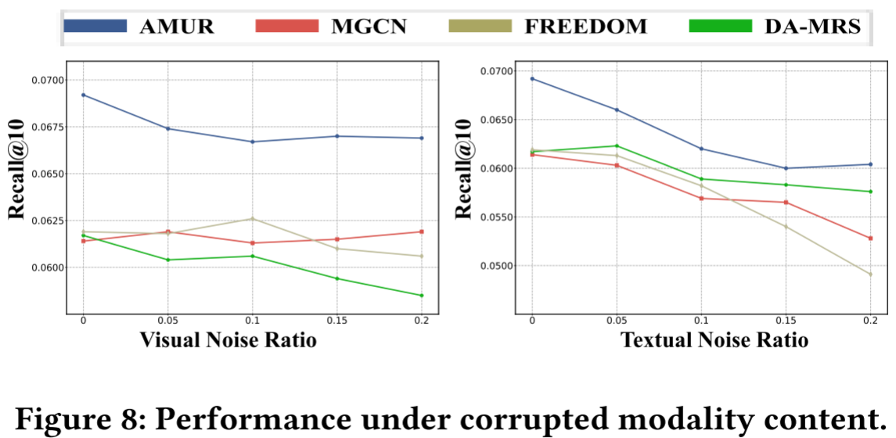
ATAI
Advanced Technique of Artificial Intelligence
ATAI
ChongqingUniversity _{AdvancedTechniqueof}
of Technology Artificial Intelligence
Chongqing University of
Technology
Chongqing University ^{ATAI}
_{of Technology} Advanced Techniqueof
Artificial Intelligence
Chongqing University of Technology
Chongqing University of Technology

Slide 17
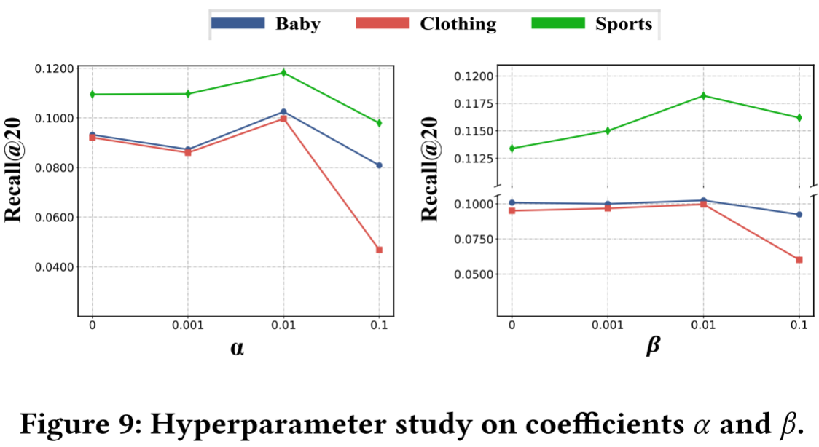
ATAI
Advanced Technique of Artificial Intelligence
ATAI
ChongqingUniversity _{AdvancedTechniqueof}
of Technology Artificial Intelligence
Chongqing University of
Technology
Chongqing University ^{ATAI}
_{of Technology} Advanced Techniqueof
Artificial Intelligence
Chongqing University of Technology
Chongqing University of Technology

Slide 18
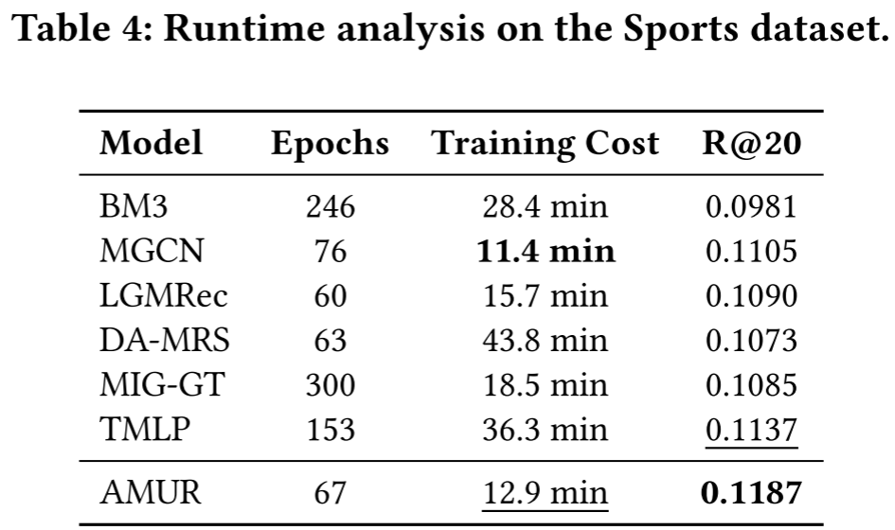
ATAI
Advanced Technique of Artificial Intelligence
ATAI
ChongqingUniversity _{AdvancedTechniqueof}
of Technology Artificial Intelligence
Chongqing University of
Technology
Chongqing University ^{ATAI}
_{of Technology} Advanced Techniqueof
Artificial Intelligence
Chongqing University of Technology
Chongqing University of Technology

Slide 19


ATAI
Advanced Technique of
Artificial Intelligence
ATAI
ChongqingUniversity _{AdvancedTechniqueof}
of Technology Artificial Intelligence
Chongqing University of Technology
Thanks!

